Slide 1
Nick Hartshorne-Evans – President of iHHub
22nd March 2016 - Firenze

Slide 2
GROWING GLOBAL
AWARENESS OF HEART
FAILURE 2016-17
May 2016

Slide 3
Vision and strategy

Slide 4

Building iHHub
01
Building a community
02
Creating a global disease awareness campaign
03
Amplifying the patient voice
04
Creating a global conversation
05

Slide 5
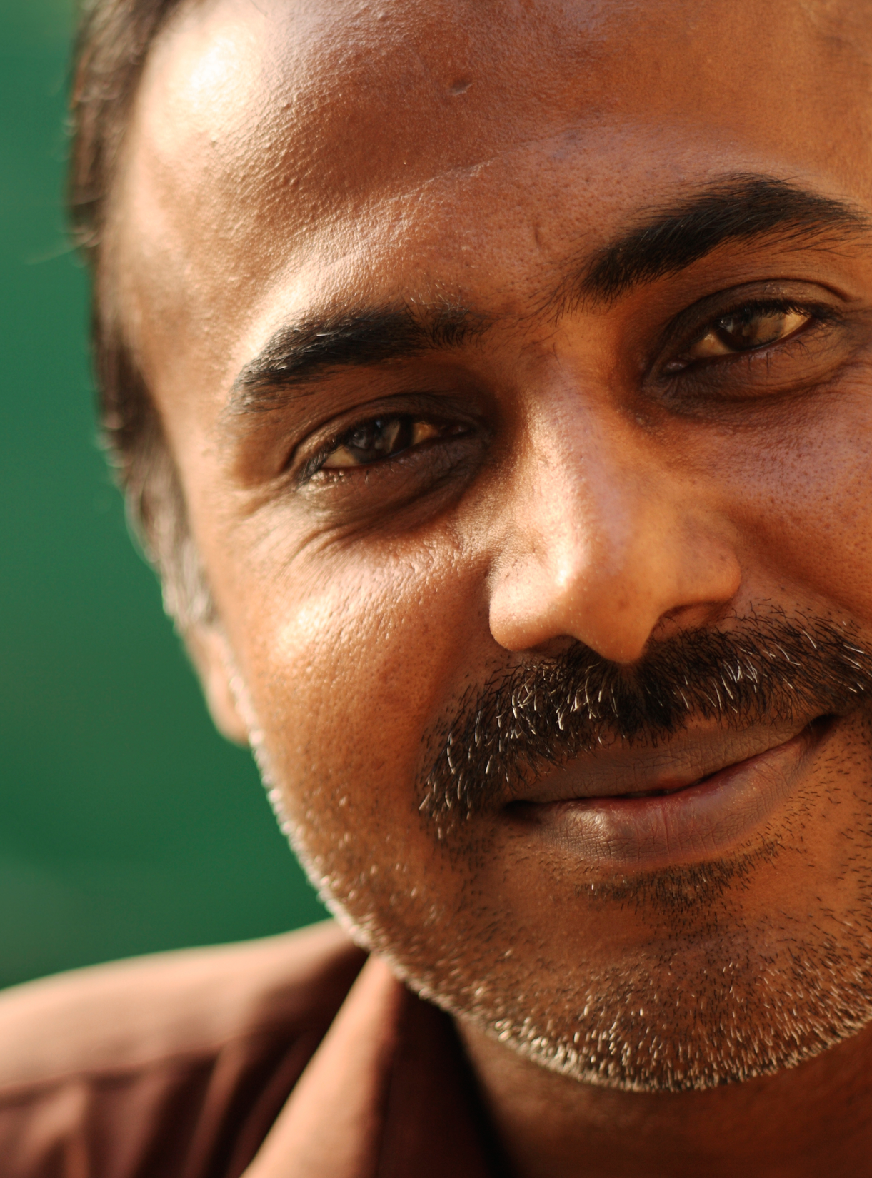
GLOBAL CONTEXT
The voices of more than 26 million people living with heart failure are not being heard.¹
Heart failure causes 2-3 times as many deaths as advanced cancers like bowel and breast cancer.²
In economically developed countries, up to 1 in 5 people are expected to develop heart failure in their life.³
1. Ambrosy AP et al. J Am Coll Cardiol 2014;63:1123–33. doi: 10.1016/j.jacc.2013.11.053
2. Stewart et al. More ‘malignant’ than cancer? Five-year survival following a first admission for heart failure Eur J Heart Fail. 2001;3:315322
3. Lloyd-Jones DM, Larson MG, Leip EP et al. Lifetime risk for developing congestive heart failure: the Framingham Heart Study. Circulation 2002;106:3068-72.

Slide 6

GLOBAL CONTEXT
Before iHHub there was no global representation and little local representation for patient groups specifically for heart failure.
1. Ambrosy AP et al. J Am Coll Cardiol 2014;63:1123–33. doi: 10.1016/j.jacc.2013.11.053
Notes:
1. Ambrosy AP et al. J Am Coll Cardiol 2014;63:1123–33. doi: 10.1016/j.jacc.2013.11.053

Slide 7
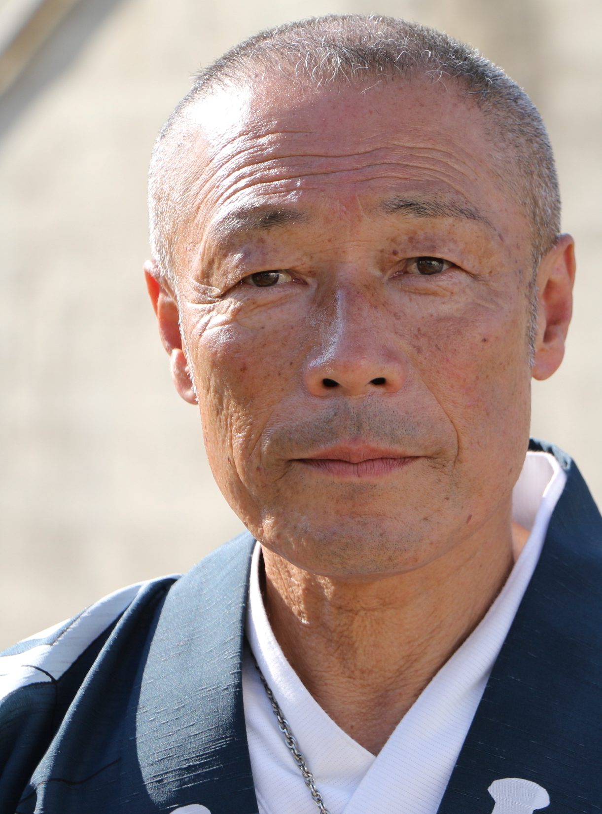
OUR VISION
To unite people across the world to extend and improve the lives of people living with heart failure.

Slide 8

OUR MISSION
To bring together and support the initiation of patient groups from every country in the world creating a global heart failure community.

Slide 9

OUR STRATEGY
To make iHHub a tangible and credible entity recognised by the global heart failure community.

Slide 10
Our focus for 2016 /2017
1
Position iHHub as the global voice of heart failure patient groups
2
3
4
Build a community of patient group affiliates
Create a global disease awareness campaign
Amplify the patient voice
2016
5
Create a global conversation
2017

Slide 11
Building iHHub
01

Slide 12
Building iHHub
01
Key requirements:
Leadership
Brand and digital platform
Operational Team
Understanding the “needs and why”
Business Plan
Bringing Value
Execution

Slide 13
Key Messages
01
To position iHHub as the group that brings together and supports the creation of patient groups from every country in the world to raise awareness of heart failure and improve lives
COMMUNICATIONS
GOAL
We will unite people across the world to extend and improve the lives of people
living with heart failure
MAIN MESSAGE
(vision)
We need to change how people perceive heart failure
We are the hub
We will instigate global measurable change by
driving local action
DEFINING ARGUMENTS
MISSION STATEMENTS
We believe that HF is a manageable / treatable condition
We know that HF is under diagnosed, untreated, misdiagnosed and under-treated and is having a huge global economic impact
We recognise the importance
of measuring and celebrating progress
We will ensure our affiliates have visibility, viability, credibility
and community
We will provide our membership with the tools they need to
be successful
We aim to be central to all global patient centred HF conversations
We will create connections between organisations that serve HF patients
We recognise the vital role
that local organisations play
in driving real change
We will define and clarify the severity of the problem and
make it understandable to all audiences.
We cannot do this alone, we need to collaborate with the patient, medical and political communities around the world

Slide 14
Building a community
02

Slide 15











Building a community of patient group affiliates
02

Slide 16

Supporting member development
02
Annual Member Summit:
Bringing together all iHHub members
Pre-meeting survey to ascertain agenda from members
Share experiences from around
the world
Educational up skilling workshops
Networking opportunity

Slide 17

Supporting member development
02
Member toolkit:
Develop materials to support patient champions / existing groups drive their agendas at their country level:
  Why set up a PAG?
  How to set up a PAG?
  Relationship Management
  Tutorials on building an identity and a brand, communications strategy, building a website, using traditional and social media, sourcing funding, driving membership and developing a stakeholder engagement strategy through the “Multi-Disciplinary Team”

Slide 18
Create a global disease awareness campaign
03

Slide 19
Global awareness campaign
03
Key objectives:
Create a global patient leadership position
Create a global patient movement through members
Give people the “why” and how they relate to Heart Failure
Create Global, Regional and Country led conversations

Slide 20
Amplifying the patient voice
04

Slide 21
Amplifying the patient voice
04
Opportunities:
Enabling members to engage with their country communities
Sharing ideas of how to ensure people “believe” in their group
Assisting the understanding of why and how to build communities both on and offline
Creating a community voice, unlocking advocates
Interlock the country groups developing “one voice”

Slide 22
Create a global conversation
05

Slide 23
Create a global conversation
05
Challenges:
The worlds a big place!
Different conversations, different cultures
No unified voice
It’s a question of money or numbers or both
Money is finite, collaboration is everything
iHHub members set the tone and conversation
Use the community, BIG DATA works globally
Demonstrate value – The patient opinion is key to the conversation
Solutions:

Slide 24
Questions

